Slide 1
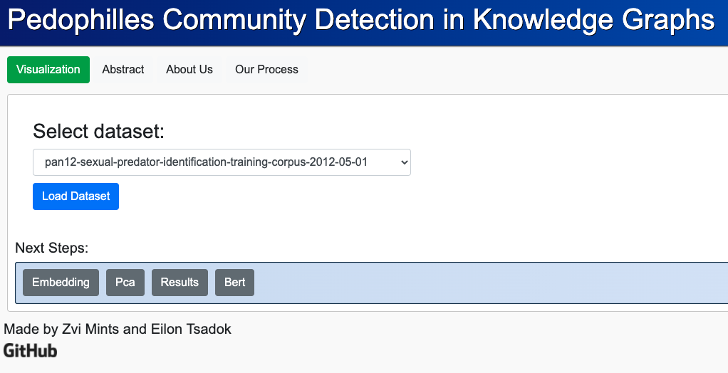
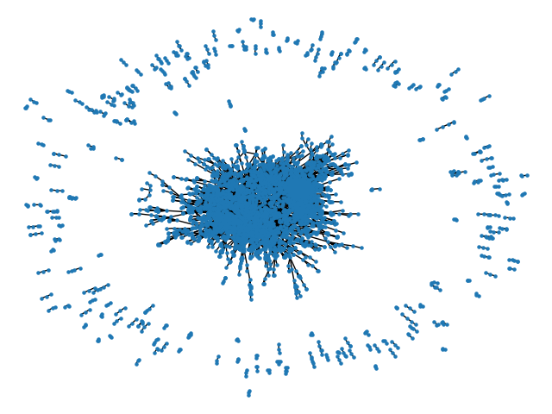
[Poster Describe Research and Software Development Project]
Eilon Tsadok (304950645) and Zvi Mints (314977489) Instructed by Or Anidjar and Amit Dvir
Contribution/project goal
We will explore how to benefit the knowledge that can be extracted from a Knowledge Graph, in order to detect a community of pedophilles with some charachteristics
Introduction
Detection of pedophilles impersonators and their textual content shared over the Internet via conversations.
We will apply a clustering algorithm’s in order to detect communities of users that are sharing close enough behavioral patterns and create a visualization API which can be replayed with new dataset to preform new analysis
Selected Approach
We will use network and node2vec to define the conversation structure that will serve as Knowledge Graph.
We will use Kmeans, Spectral Clustering and Connected Components algorithms to cluster the data.
We will take advantage of the recently based language modelling developed by Google corpora, which is called BERT to decode the conversations content
Solution:
Live Demo
Results
Technologies and Flow
Dataset
node2vec
PCA
KMeans
BERT
Spectral Clustering
Flask & React
Connected Components
https://github.com/ZviMints/Final-Project/

